Slide 1

Maze Game
The Coders

Slide 2
Contenders
Mario Boshev– Scrum trainer
Venilin Donchev – QA Engineer
Petar Nikolov – Back-End
Kiril Dimitrov – Front-End

Slide 3
How to play the game?
Our Maze game is written on C++ for 1 player. The game consists of a playing field(labyrinth) 20X10, where the main point of the game is to reach the exit. The character is controlled by W,A,S,D as input from the keyboard.

Slide 4
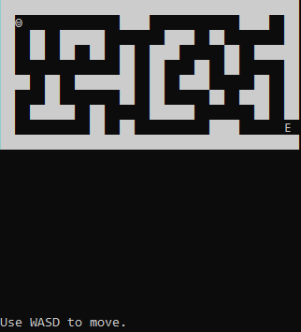
Instructions
Legend:
██ - wall
☺ - character
E - Exit

Slide 5
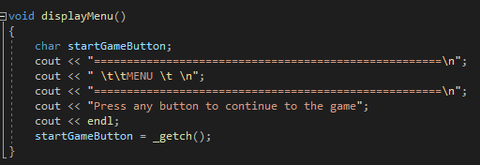
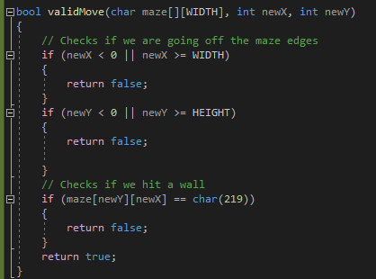
Functions of the game
Main menu
Checks our moves

Slide 6
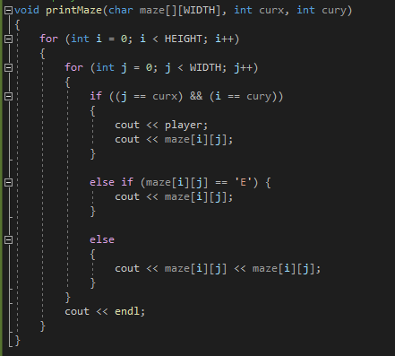
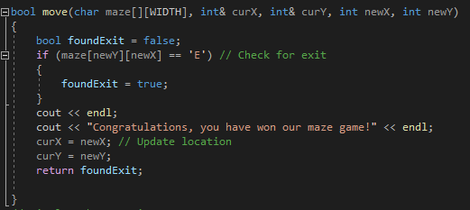
Layout of the labyrinth
Checks if we have reached the exit

Slide 7






Apps used for the making of our project

Slide 8
Thank you for your attention!

